Slide 1

The singing voice research: the state-of-the-art
Sound & Music Computing Lab
Chitralekha Gupta, Karim Magdi, Dania Murad

Slide 2
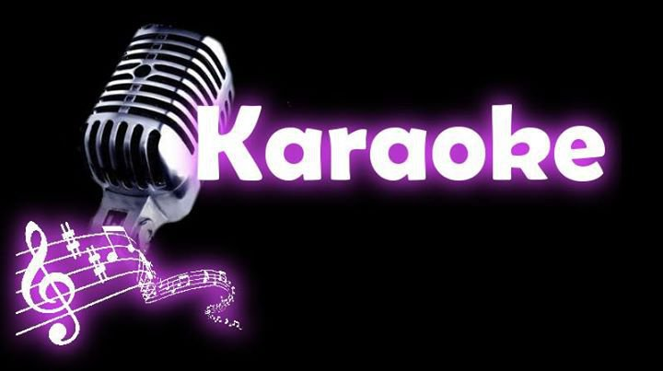
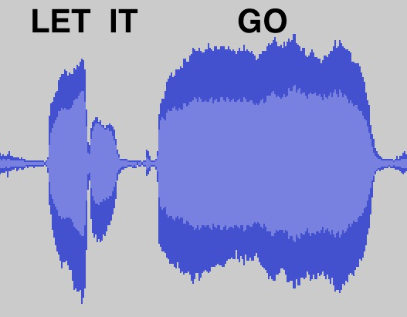

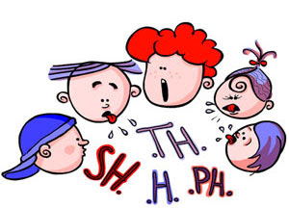
Why Singing Voice Research?
Sound & Music Computing Lab
Music Information Retrieval
Edutainment
Singing-to-Text transcription
Singing-to-Lyrics alignment
Query-by-singing
Singing learning and scoring
Speech Therapy
Language Learning
Music Therapy for Speech
Disorders
Pronunciation Evaluation
Intelligible Song Recommendation

Slide 3
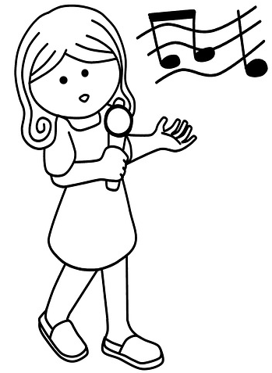
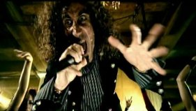
Research Directions
Sound & Music Computing Lab
Singing Voice
Quality Assessment
Pronunciation Assessment
Intelligibility in Music
SAY WHAT???
Notes:
Singing voice quality assessment: How well do you sing?
Singing Voice Pronunciation Assessment: How good is your pronunciation in singing?
Singing Voice Intelligibility in Music: How intelligible a song is in presence of background music?

Slide 4

Singing Quality Assessment
Sound & Music Computing Lab
Reference
Better
Poor
?
?
How do experts perceptually assess singing quality?
Intonation Accuracy
Rhythm Consistency
Appropriate Vibrato
Voice Quality
Pitch Dynamic Range
Pronunciation

Slide 5
How do we teach a machine to evaluate singing quality?
Sound & Music Computing Lab
Perceptual Evaluation of Singing Quality*
Signal processing-based objective features for pitch, rhythm etc.
Reference singing
Cognitive Modeling
Regression
PESnQ score
Test singing
*Chitralekha Gupta, Haizhou Li, and Ye Wang. “Perceptual Evaluation of Singing Quality”, Asia-Pacific Signal and Information Processing Association (APSIPA), Kuala Lumpur, Dec. 2017
Notes:
Use signal processing methods to describe the percpetual parameters like pitch, rhythm etc.

Slide 6
Sound & Music Computing Lab
How to measure Rhythm Consistency?
REFERENCE
Same words, but speed varies!
TEST
Which spectral feature represents words or the lyrical content?
MFCC
We “aligned” the MFCC vectors of reference and test singing signals – HOW?

Slide 7
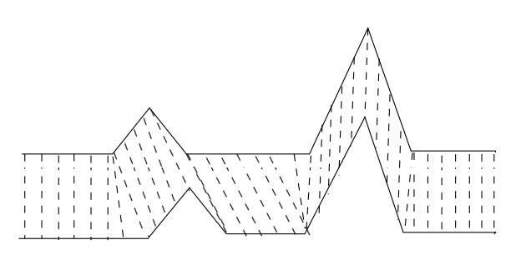
Sound & Music Computing Lab
Rhythm Consistency
Dynamic time warping (DTW) measures the similarity between two temporal sequences, which may vary in speed
REFERENCE
TEST

Slide 8
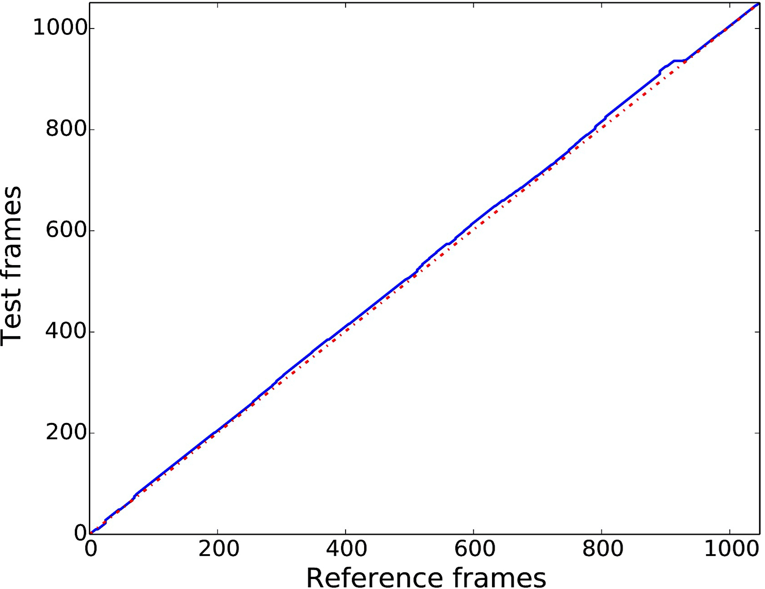
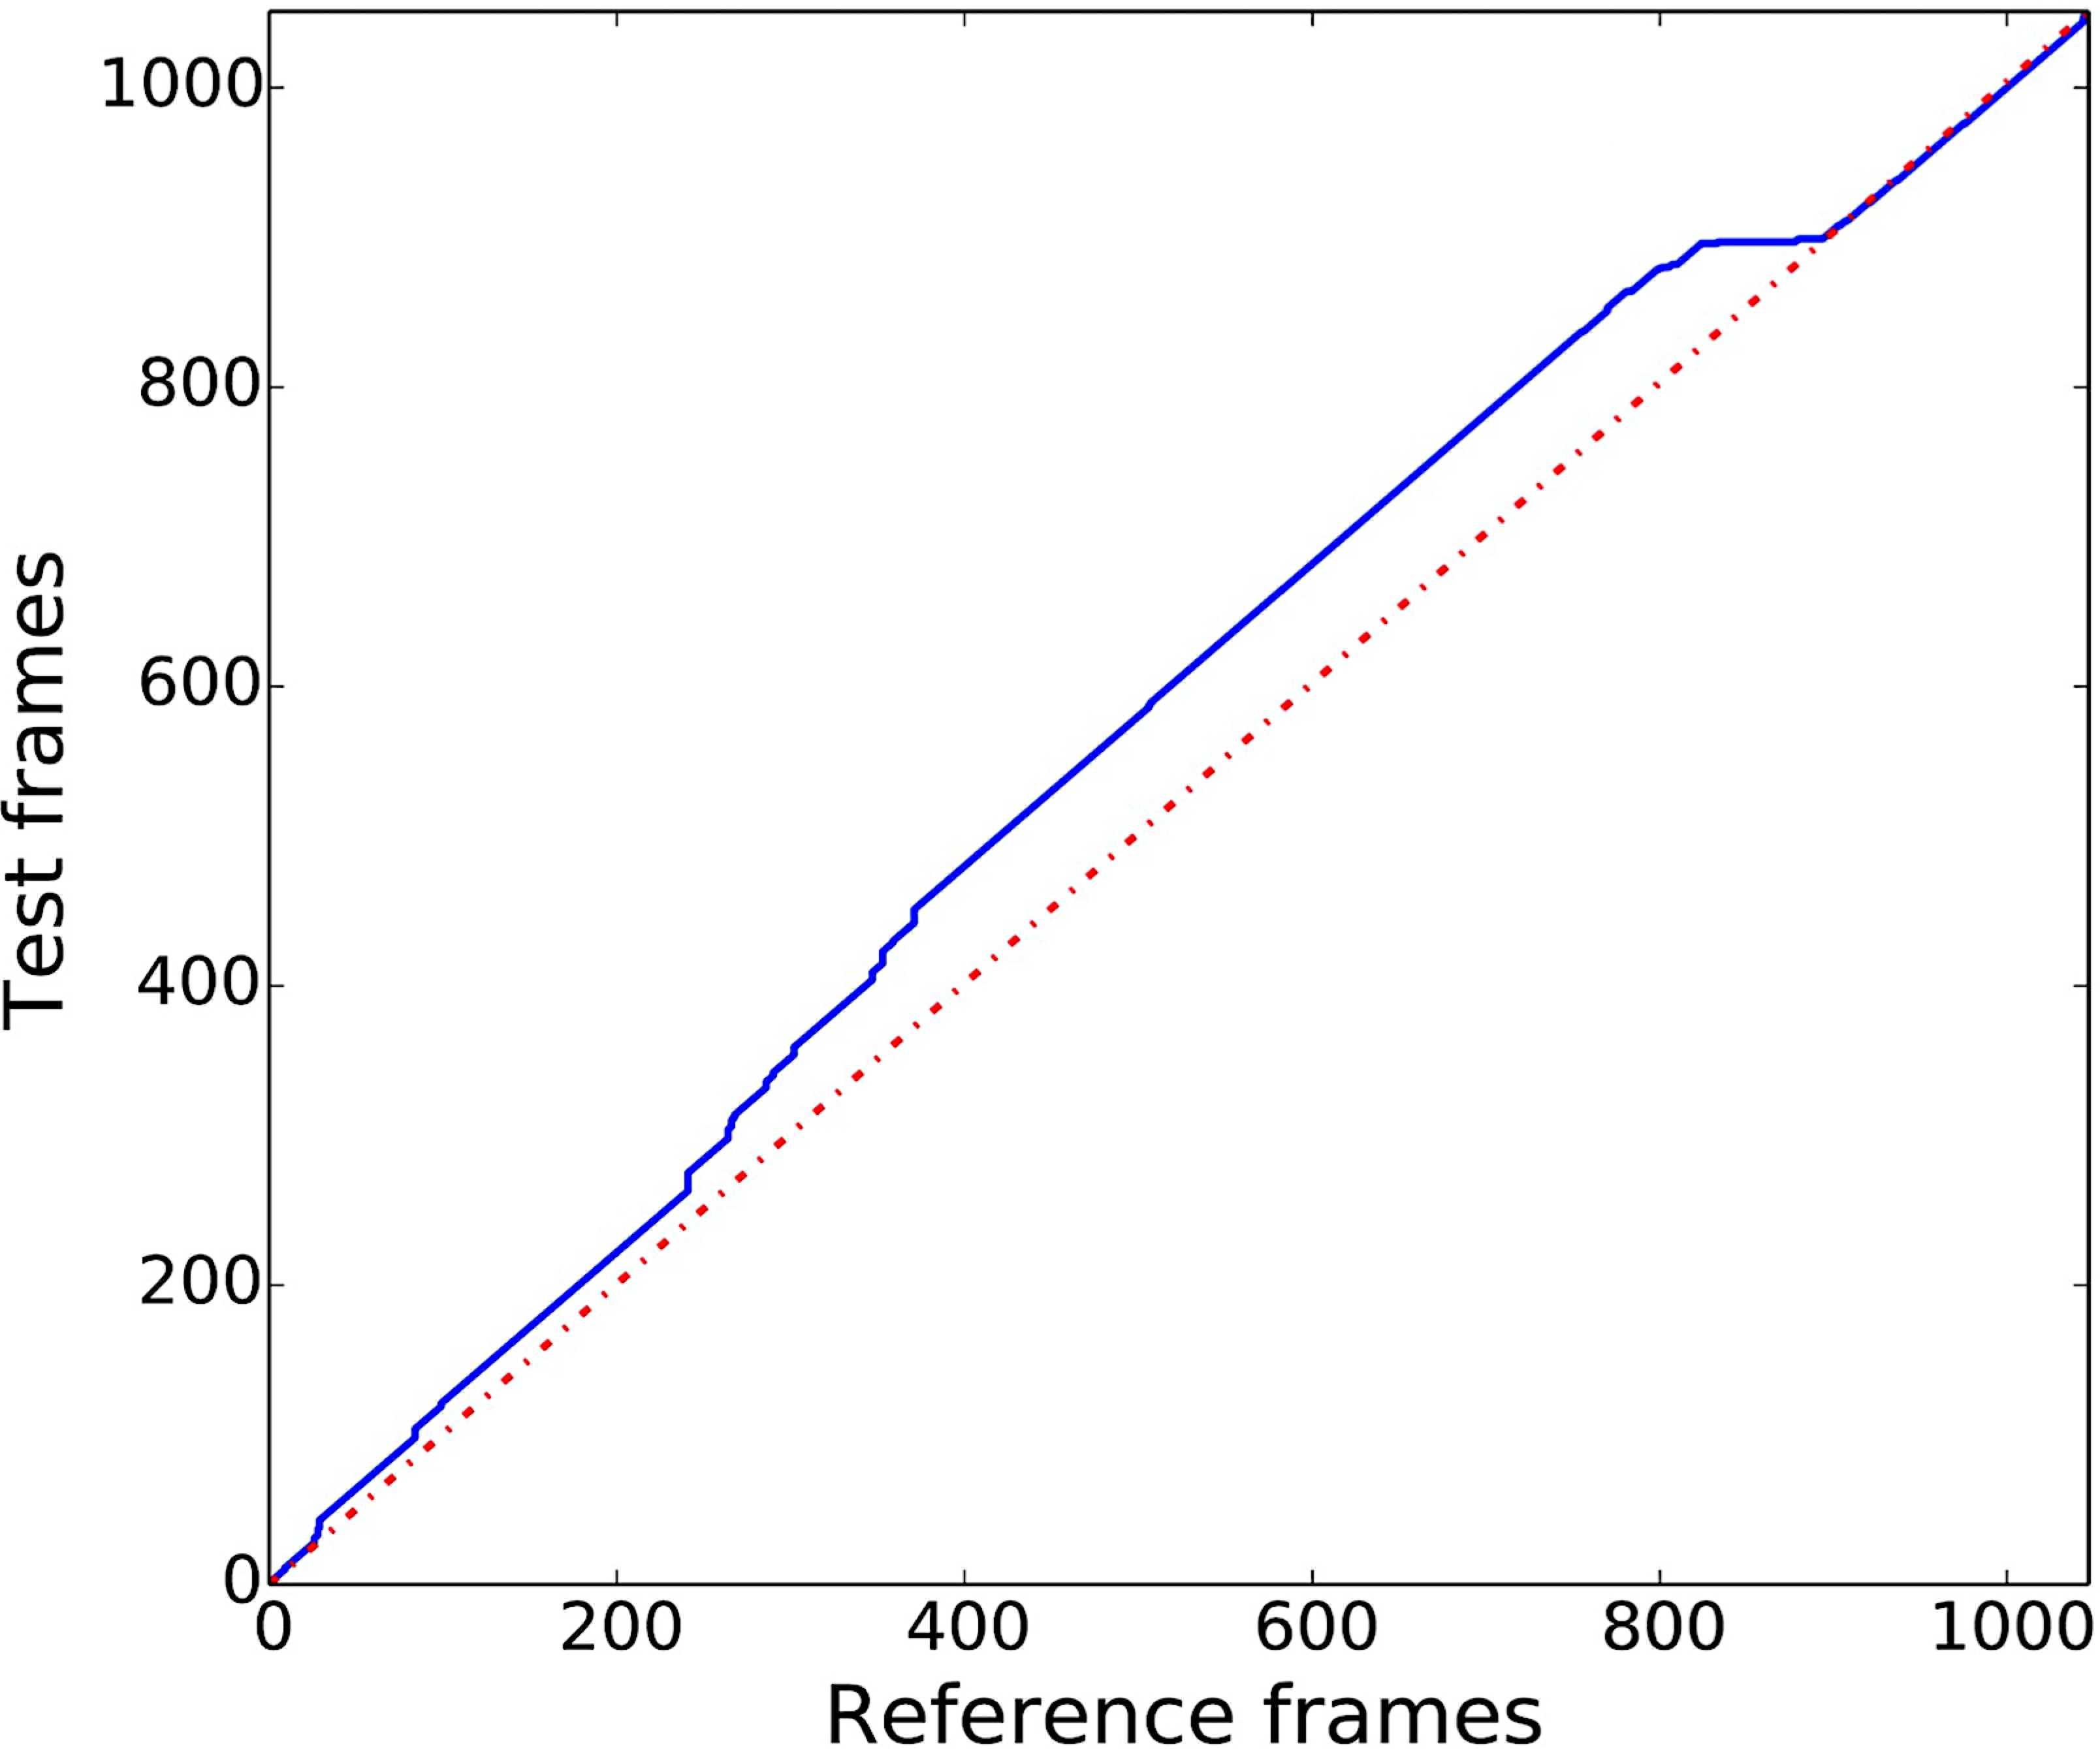
Sound & Music Computing Lab
Rhythm Consistency
Use DTW of MFCC vectors between reference and test
Reference Vs. Good Reference Vs. Poor
Notes:
What do MFCC vectors represent in singing signal?

Slide 9
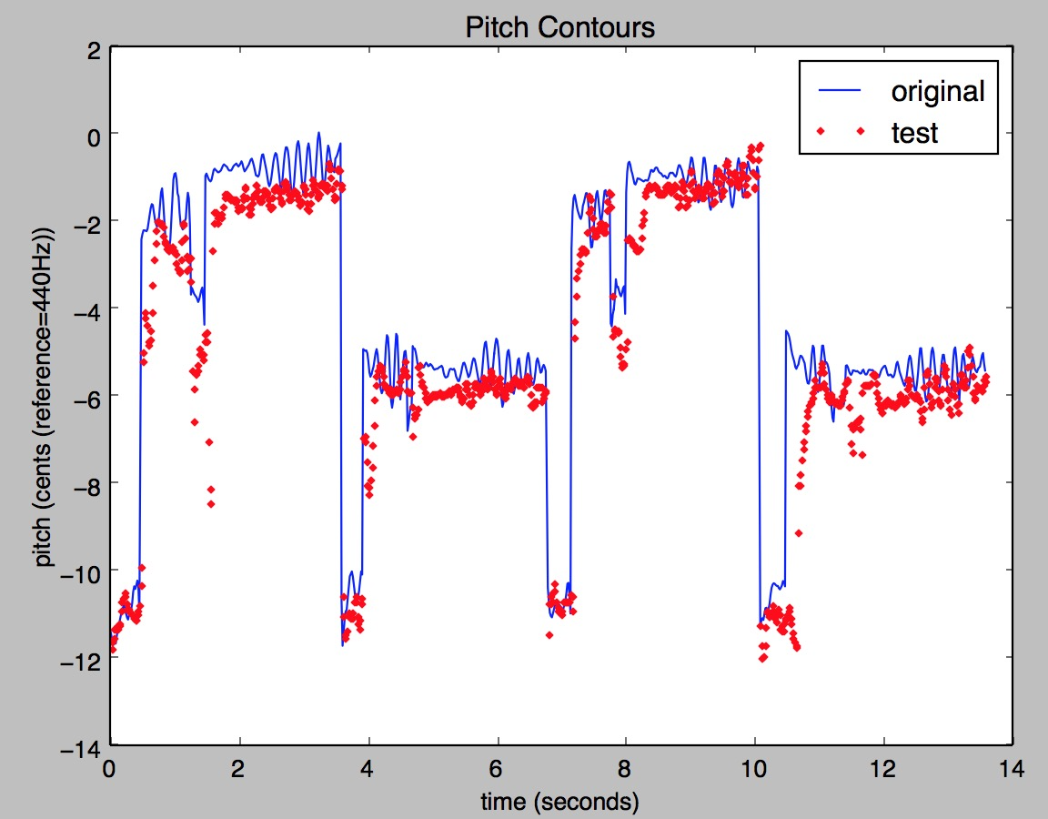
Intonation Accuracy
Sound & Music Computing Lab
Which feature represent intonation or melody?
Compute the distance between the pitch contours from reference and test signals
What is the problem with this?
Key transposition will be penalized!
Notes:
Which feature represents intonation or melody?

Slide 10
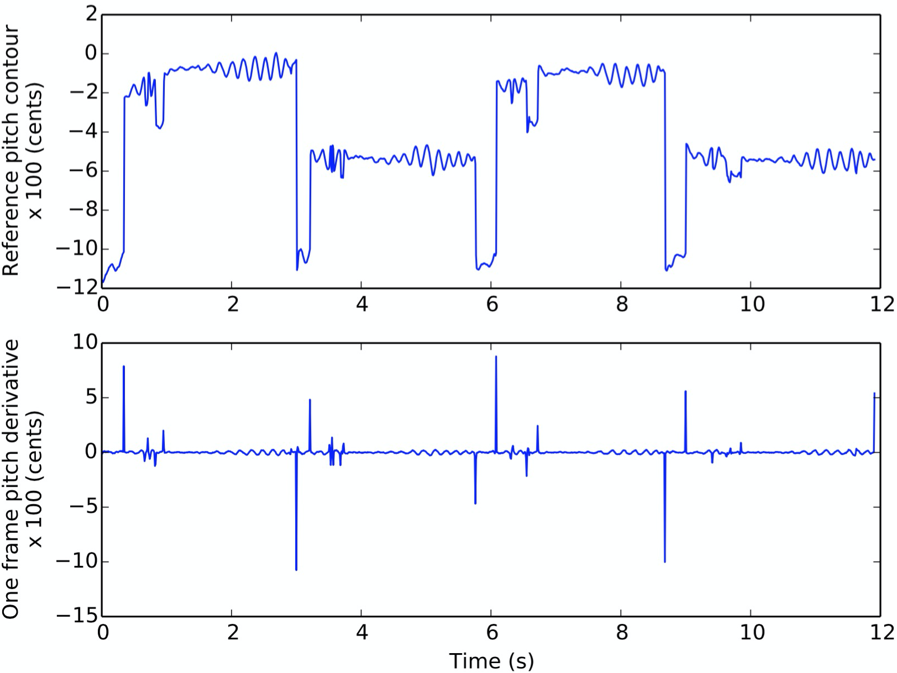
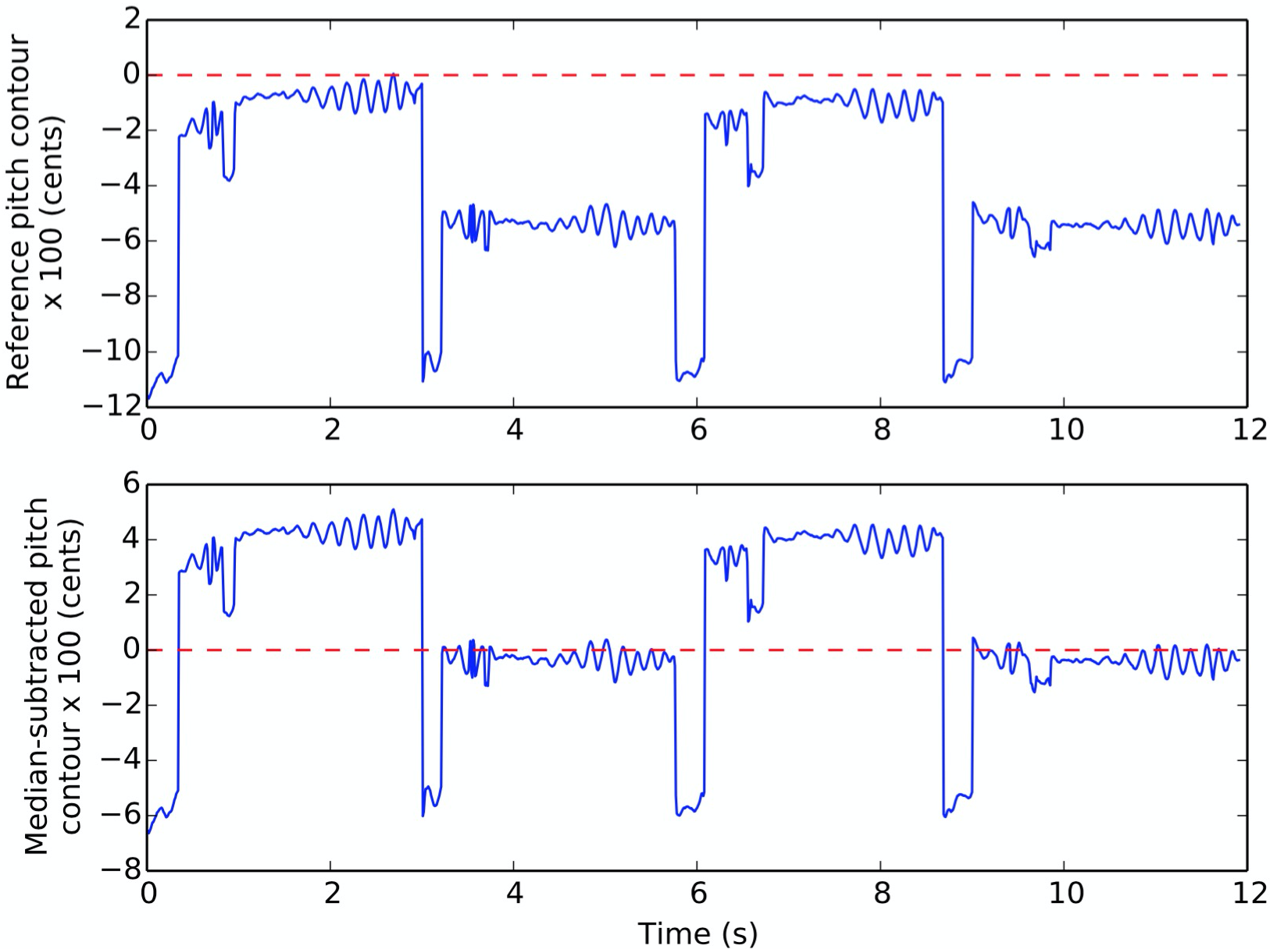
Intonation Accuracy
Sound & Music Computing Lab
Key transposition should be allowed → pitch derivative, and median-subtracted pitch
Pitch derivative Median-subtracted pitch

Slide 11
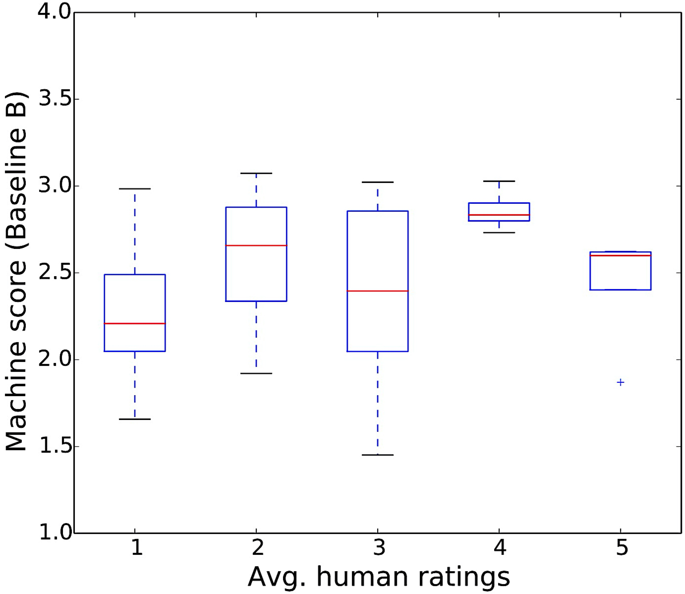
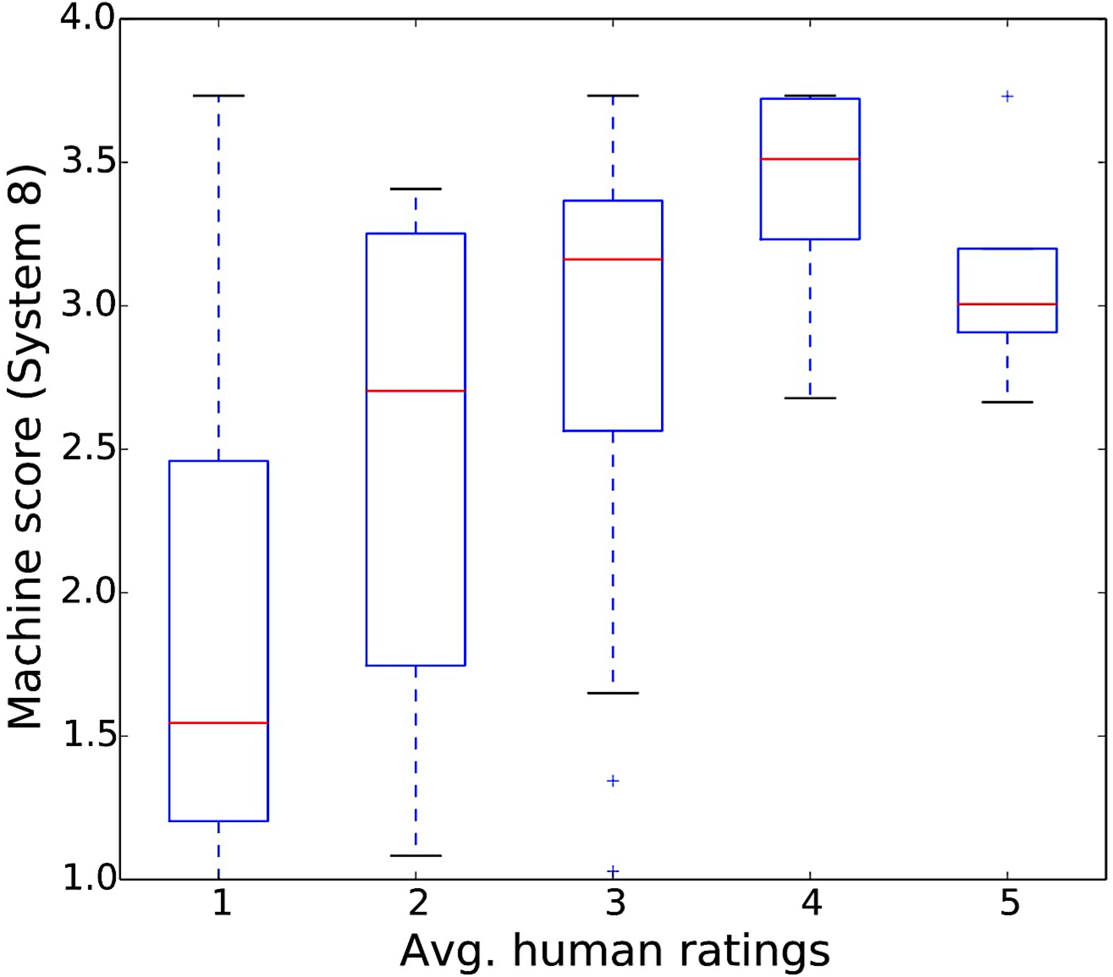
Sound & Music Computing Lab
Results
Baseline – distance features PESnQ
Adopting the cognitive modeling theory of PESQ to design a PESnQ score shows 96% improvement over baseline scores in correlating with the music-expert human judges

Slide 12
Singing Pronunciation Assessment
Sound & Music Computing Lab
Learning a second language (L2) through singing is shown to be effective and is used in pedagogy
Automatic pronunciation evaluation of singing is desirable for L2 learning
GOAL: Automatic pronunciation error detection in singing in South-East Asian English accents (Malaysian: M, Indonesian: I, Singaporean: S)
*Chitralekha Gupta, David Grunberg, Preeti Rao, and Ye Wang. “Towards Mispronunciation Detection in Singing”, ISMIR 2017, Suzhou, China, Oct. 2017

Slide 13
Error patterns in South-East Asian English accents
Sound & Music Computing Lab
What are the error patterns observed in non-native singing compared to non-native speech?
From speech analysis literature
ID | Error | Examples
C1 | /dh/→/d/ | thy → die; mother → moder
C2 | /th/→ /t/ | thought → taught; nothing → noting
C3 | /t/→ /th/ | to→thu; sitting → sithing
C4 | /d/→ /dh/ | dear → dhear
CD | Word-end consonant deletion | moment → momen
R | Rolling /r/ | ray → rray
V | vowel error | fool→full; sleeping→slipping
Are all of these error patterns also observed in singing?

Slide 14
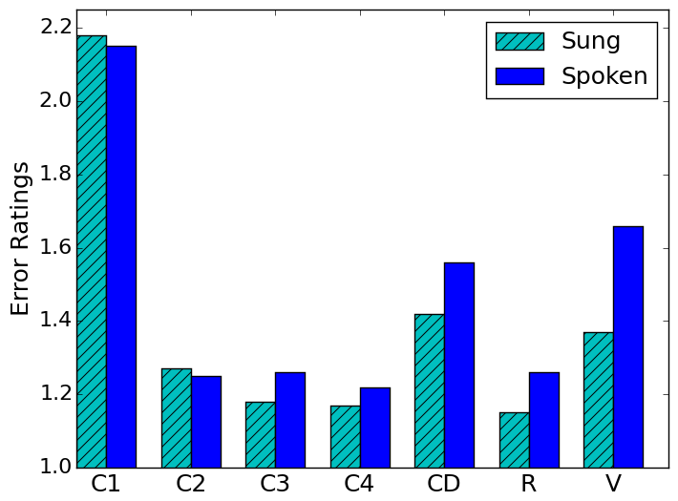
Subjective analysis
Sound & Music Computing Lab
Findings:
Consonant Deletion and Vowel errors are significantly lower in singing than in speech
Key Insight: Only a subset of the error patterns that occur in speech occur in singing - suggests a possible learning strategy

Slide 15
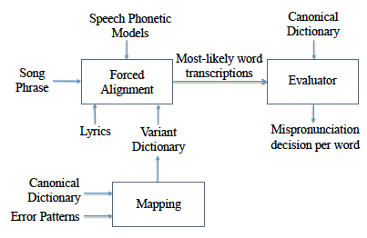
Automatic Evaluation Framework
Sound & Music Computing Lab
Converted all pronunciation patterns into a dictionary of words with acceptable and unacceptable pronunciation variants
“LEX” method
Notes:
Segmentation and Evaluator stages – 2 stage system

Slide 16
Results
Sound & Music Computing Lab
 | Dictionary A | Dictionary B
Definition | only American English phones (L2) | American phones+modified (L1-adapted) phone
Example | /th/ | /th/, /cl/+/th/
F-score | 0.63 | 0.67
We provided rules that predict singing mispronunciations for a given L1.
L1-adapted dictionary to detect mispronunciation in singing
Notes:
Next, Dania will talk about an application that she built that evaluates pronunciation in singing

